Slide 1

A Project Review Meeting on College Canteen Token System
By
Name : MEGHANA Roll no : 2520030245
Name : SAHASRA Roll no : 2520030108
Team Number: 27
Under the guidance of
D.PAVITHRA
ASSISTANT Professor
Department of Computer Science and Engineering
Koneru Lakshmaiah Education Foundation (Deemed to be University estd. u/s. 3 of the UGC Act, 1956) Off-Campus: Bachupally-Gandimaisamma Road, Bowrampet, Hyderabad, Telangana - 500 043. Phone No: 7815926816, www.klh.edu.in

Slide 2
Outline of the Presentation
Abstract
Introduction
Problem Statement
Project Flow Diagram
Objectives with Justification
Modules[Frontend web pages]
Expected Outcomes of the Proposed Work
Conclusion
References

Slide 3
Abstract
• The College Canteen Token System is a web-based application developed to modernize and automate the food ordering process in college canteens.
• In traditional canteen systems, students often face long queues, delays in ordering, and difficulties in collecting food during peak hours. These issues result in time wastage and reduced efficiency.
• The proposed system provides a digital platform where students can register, log in, browse food categories, select menu items, add items to a cart, and generate digital tokens for their orders.
• The application also includes features such as billing, order history tracking, and feedback collection, making the ordering process more organized and user-friendly.
• By automating order management and token generation, the system reduces manual effort, minimizes human errors, and improves service quality.

Slide 4
• The project is developed using ReactJS, HTML, CSS, and JavaScript, providing an interactive, responsive, and easy-to-use interface for users.
• The system helps save time, improves operational efficiency, enhances customer satisfaction, and provides a reliable solution for effective canteen management.
• Overall, the College Canteen Token System serves as a smart and efficient platform that simplifies food ordering and contributes to a better canteen experience for both students and management.

Slide 5
Introduction
• College canteens often face overcrowding during lunch breaks and peak hours, resulting in long waiting times for students.
• Traditional canteen systems depend on manual order taking, billing, and token generation, which can lead to delays and management difficulties.
• Students spend valuable time standing in queues to place orders and collect food.
• The College Canteen Token System is designed to digitize the complete food ordering process and improve service efficiency.
• The system enables students to register, log in, browse food categories, select food items, add them to a cart, and generate digital tokens.

Slide 6
• Additional features such as billing, order history, and feedback collection provide a better user experience and improve canteen management.
• By automating these activities, the system reduces waiting time, increases operational efficiency, and enhances customer satisfaction.
• The application is developed using ReactJS, HTML, CSS, and JavaScript, providing a user-friendly and responsive interface.

Slide 7
Problem Statement
• Long Waiting Queues: Students spend significant time waiting in canteen queues during lunch breaks and peak hours, causing inconvenience and loss of valuable time.
• Manual Order Processing: Traditional canteens depend on manual order taking, billing, and token generation, which increases the chances of delays and human errors.
• Lack of Order Tracking: Students cannot easily track their orders, view previous purchases, or access order history, resulting in a poor user experience.
• Difficult Record Management: Canteen staff face challenges in maintaining order records, monitoring sales, and managing customer feedback efficiently.
• Need for a Digital Solution: A modern web-based system is required to automate food ordering, billing, token generation, and order management, thereby improving efficiency and customer satisfaction.

Slide 8
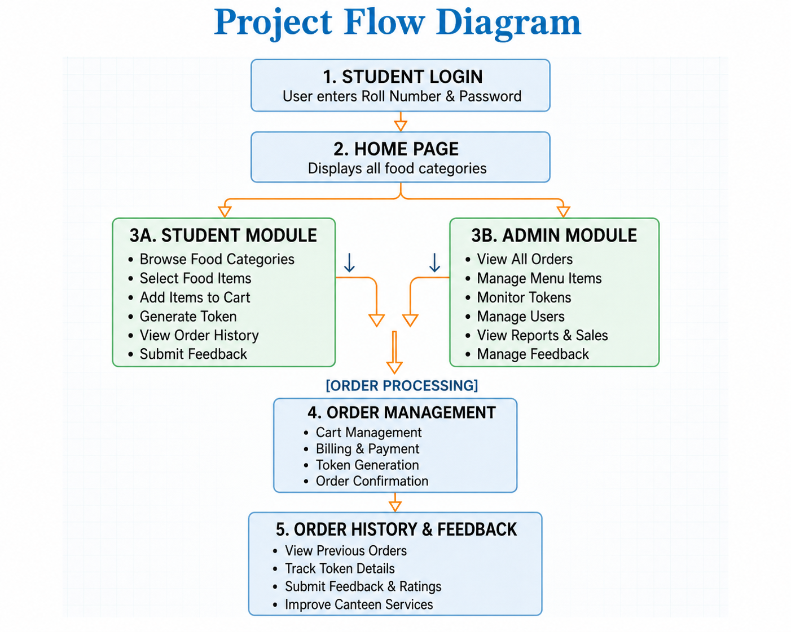

Slide 9
Objectives with Justification
• Reduce Waiting Time – To minimize the time students spend standing in long queues for ordering food and collecting tokens.
• Digital Food Ordering – To provide an online platform where students can browse menu items and place orders conveniently.
• Automatic Token Generation – To generate digital tokens automatically, reducing manual effort and improving efficiency.
• Efficient Order Management – To organize and manage food orders systematically, reducing confusion and delays.
• Order History Tracking – To allow students to view their previous orders and maintain a record of transactions.

Slide 10
• Feedback Collection – To enable students to provide ratings and suggestions for improving canteen services.
• User-Friendly Interface – To develop an easy-to-use and interactive system that enhances the overall user experience.
• Improved Canteen Operations – To help canteen management handle orders efficiently, maintain records, and improve service quality.

Slide 11
Modules [Frontend web pages]
• Login Page – Allows students to log in using Roll Number and Password for secure access.
• Registration Page – Enables new students to create an account with form validation.
• Home Page – Displays food categories and provides quick navigation to different sections.
• Menu Page – Shows food items under selected categories along with prices.
• Cart Page – Displays selected items and allows users to manage their cart.
• Billing Page – Calculates the total amount and generates the final bill.
• Token Page – Generates a unique digital token after successful order placement.

Slide 12
• History Page – Displays previous orders and token details for reference.
• Feedback Page – Allows students to submit ratings and suggestions about canteen services.
• Admin Page – Enables administrators to view orders, manage menu items, and monitor canteen activities.

Slide 13
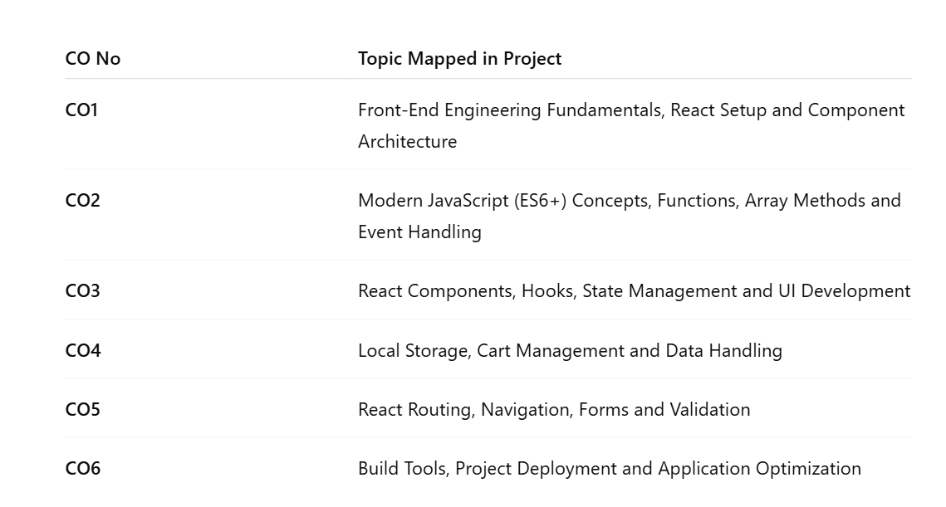
CO MAPPING

Slide 14
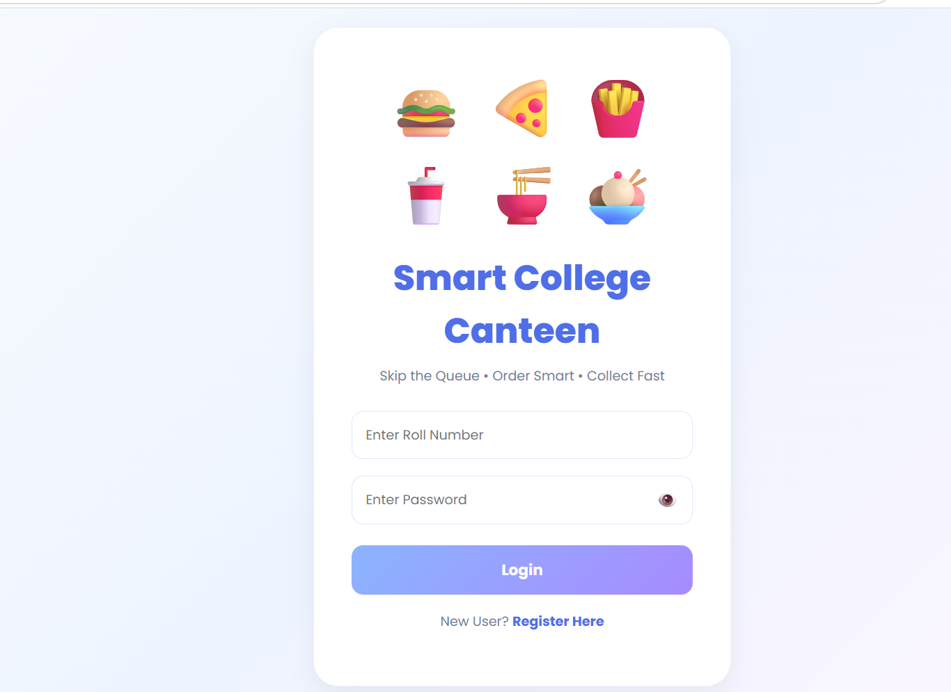
Modules [Frontend web pages]

Slide 15
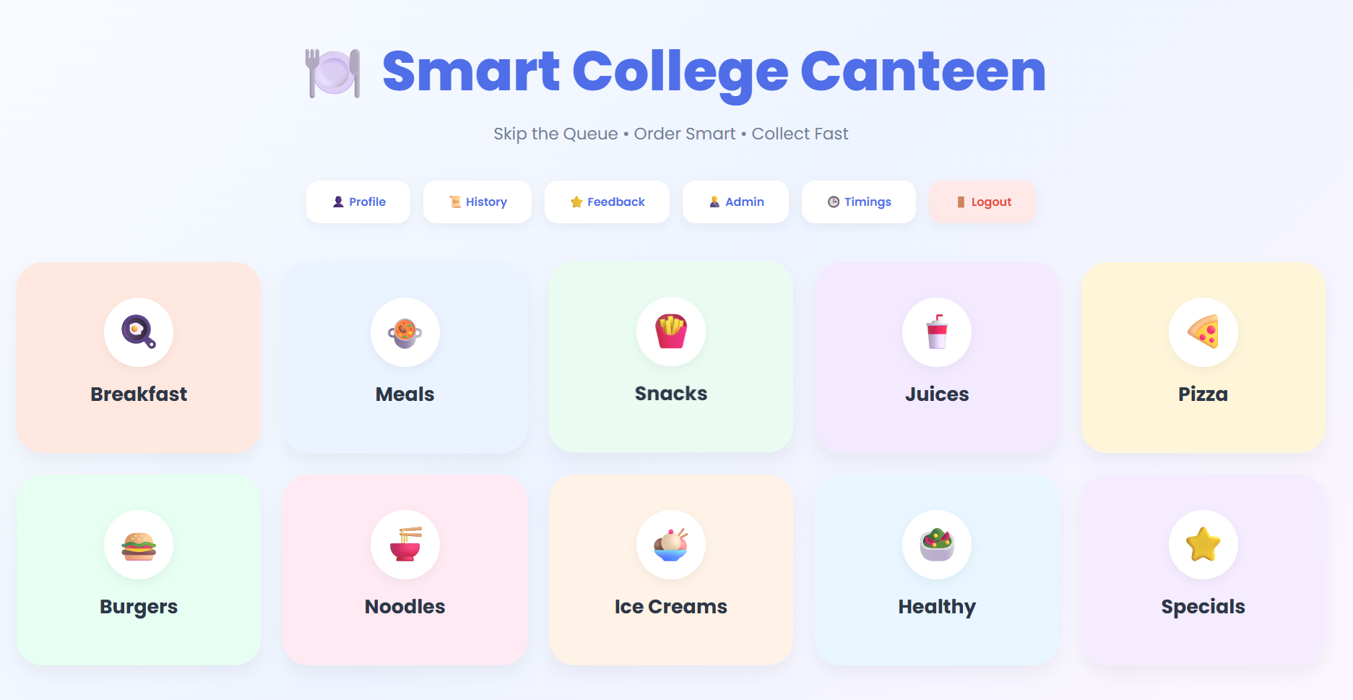
Modules [Frontend web pages]

Slide 16
Expected Outcomes of the Proposed Work
The proposed system is expected to:
Reduce waiting time in canteen queues.
Provide fast and convenient food ordering.
Automate token generation.
Improve order management.
Maintain digital order records.
Enhance customer satisfaction.
Increase canteen operational efficiency.

Slide 17
Conclusion and Future Scope
Conclusion
The College Canteen Token System successfully provides a digital solution for food ordering and token generation. The system simplifies the ordering process, reduces crowd congestion, improves efficiency, and provides a better user experience.
Future Scope
Online payment integration using UPI and cards.
QR code-based token verification.
Mobile application development.
Real-time order tracking.
AI-based food recommendation system.

Slide 18
References
• ReactJS Official Documentation – Frontend development and component-based architecture.
• React Router Documentation – Navigation and routing between application pages.
• MDN Web Docs (JavaScript) – JavaScript concepts and web development resources.
• W3Schools – Reference for HTML, CSS, JavaScript, and ReactJS tutorials.
• Research Articles on Canteen Management Systems – Understanding digital food ordering and token management systems.

Slide 19
Thank you

